Slide 1

MSDB — Madurai Smart Drop Booth
From fixed booths to mobile solutions. Tagline: "Clean Madurai, Smart Rewards"

Slide 2

The Problem: Urban Waste Pressure in Madurai
Chronic littering & mixed waste
Low public incentive
Operational gaps
Residents lack tangible rewards for separating and depositing recyclables.
Irregular collection, inefficient routing, and limited data for municipal planning.
Poor segregation at source increases landfill volume and processing cost.

Slide 3
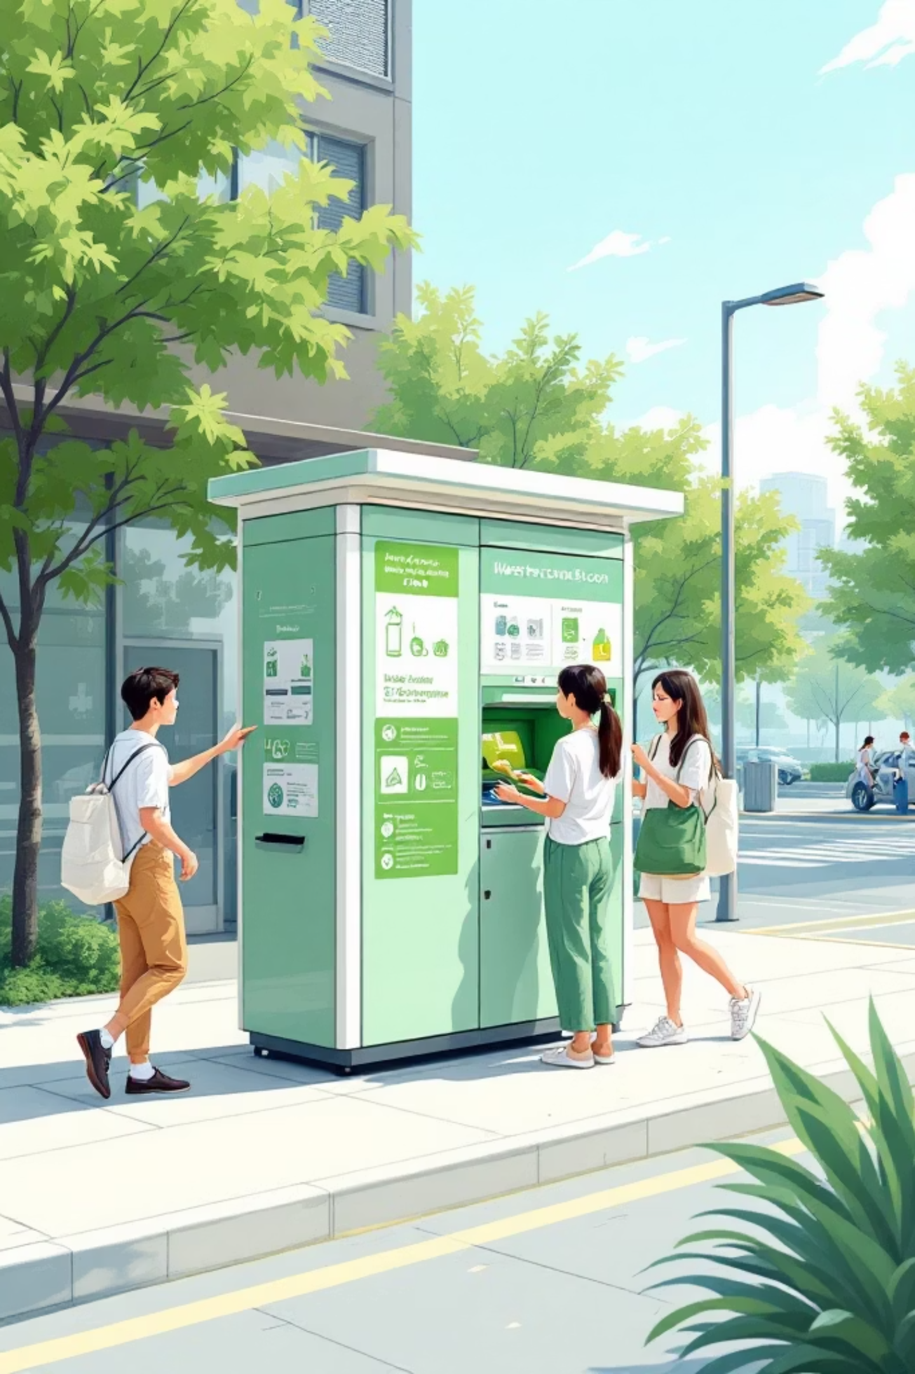
Our Solution: The Solar, IoT-enabled Booth
Chest-level deposit slot for dignity and accessibility; on-board solar + battery for continuous operation; cellular + LoRaWAN connectivity for live monitoring and control.

Slide 4

Hardware Overview
Solar canopy with weather sealing — reliable off-grid power.
Ultrasonic fill-level sensors — real-time fullness alerts.
Precision load cells — accurate weight measurement for fair rewards.
Rugged chassis, tamper sensors, and modular maintenance bays.

Slide 5
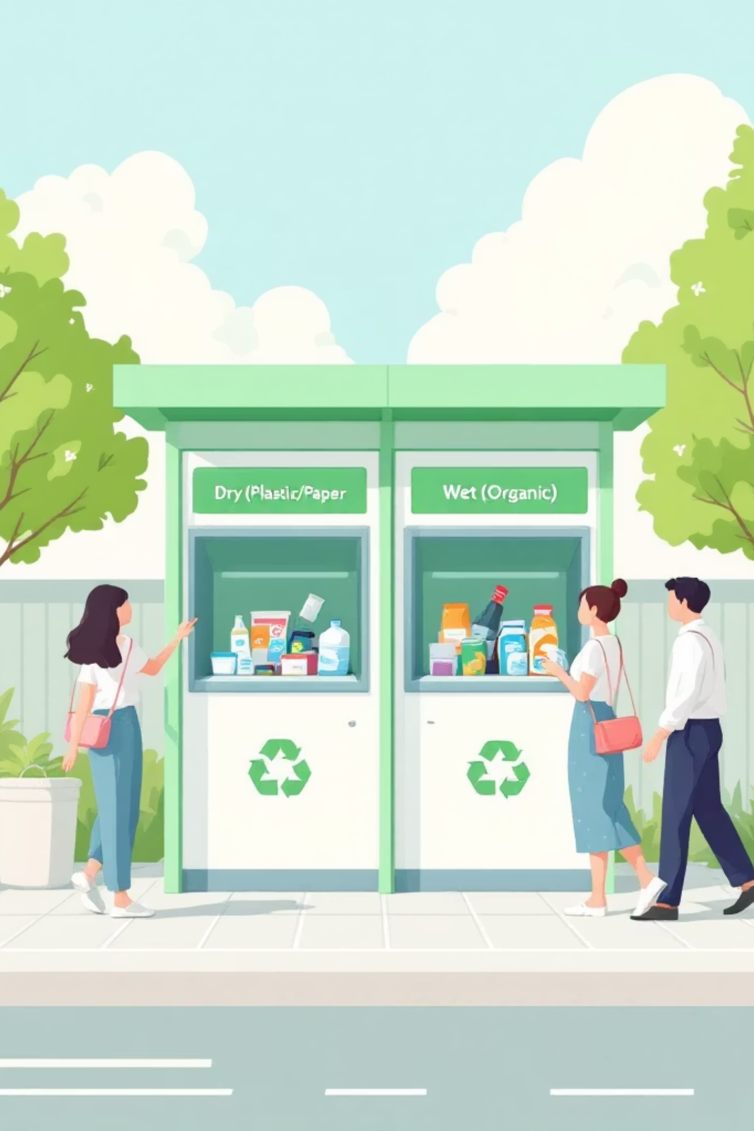
Dual-Waste Design
Separate chest-level slots for Dry (plastic, paper, metal) and Wet (organic food waste). Built-in odor control for wet compartment and removable liners for safe collection and processing.

Slide 6
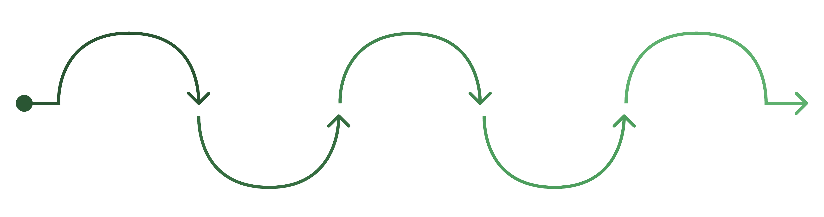
Weigh
Scan
Verify
Drop
Reward
Load cell captures and records weight
User scans QR or taps Pass
Confirm identity and waste type
Deposit material into correct slot
Points credited and synced to account
Five-step backend logic: 1) Scan QR or tap Pass, 2) Verify identity & waste category, 3) Deposit into correct slot, 4) System captures weight via load cell, 5) Points credited and synced to user account. Python-based simulation models queueing and reward accuracy.

Slide 7
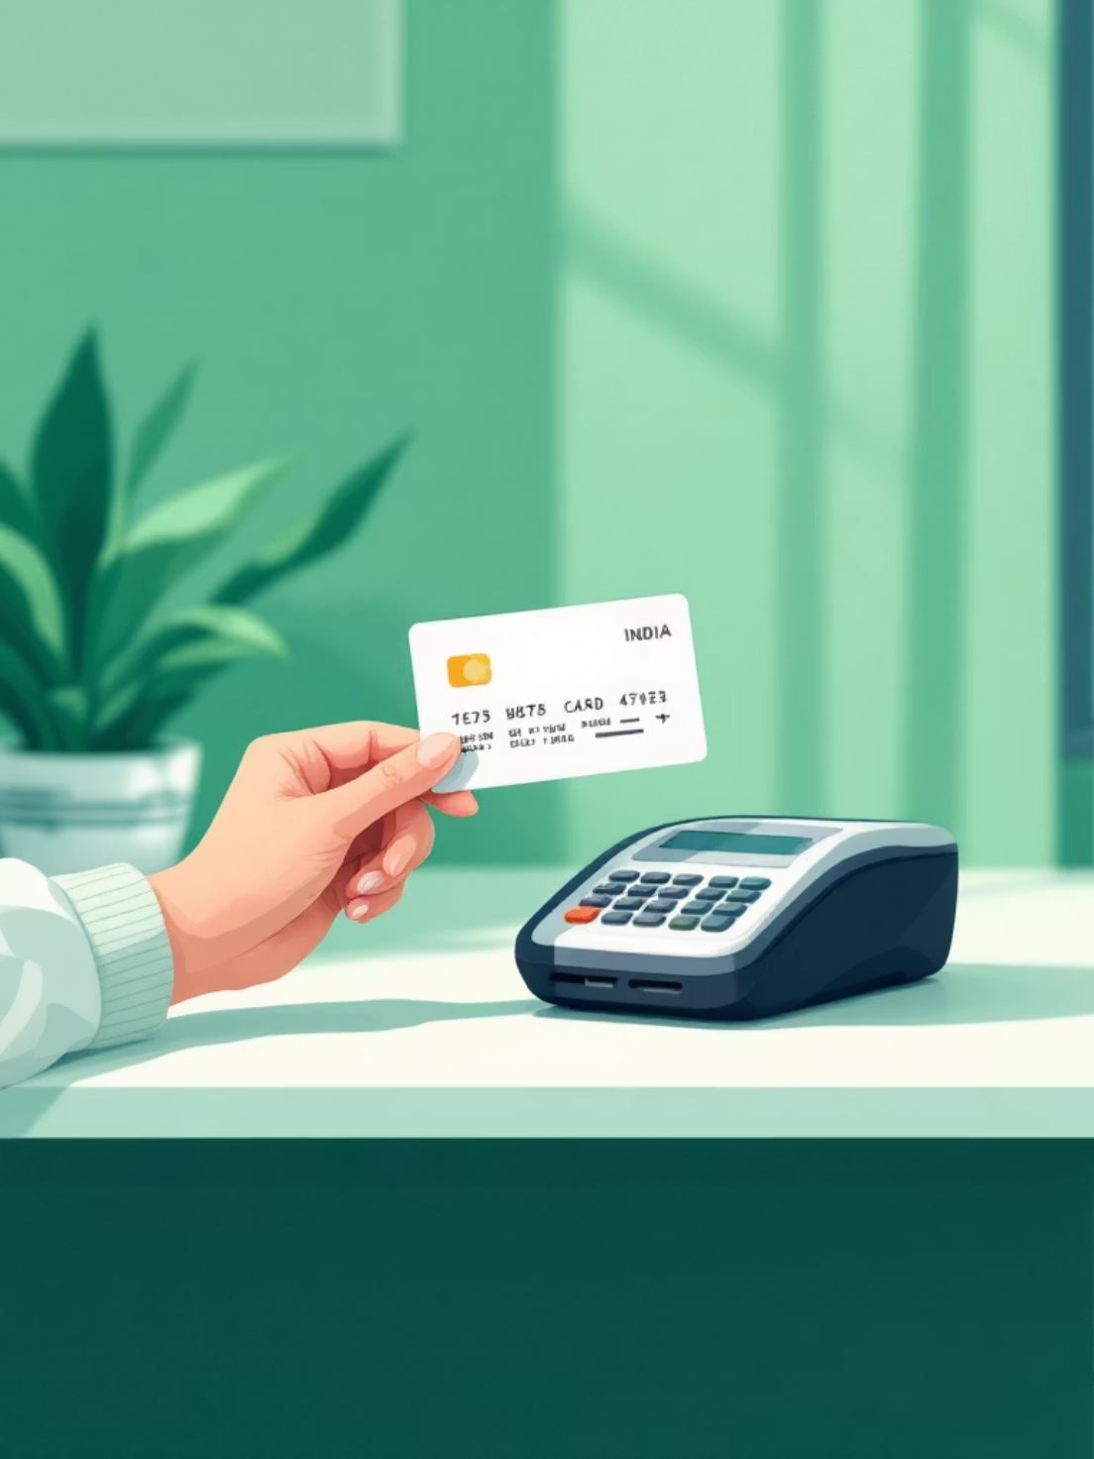
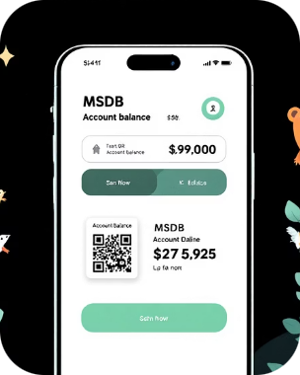
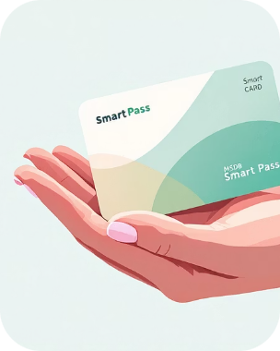
Inclusive Access
Mobile App
MSDB Smart Pass
QR login, real-time points ledger, nearby booth map, and reward catalog.
Offline NFC/pass option for users without smartphones—scan at booth to log deposits and collect points.

Slide 8
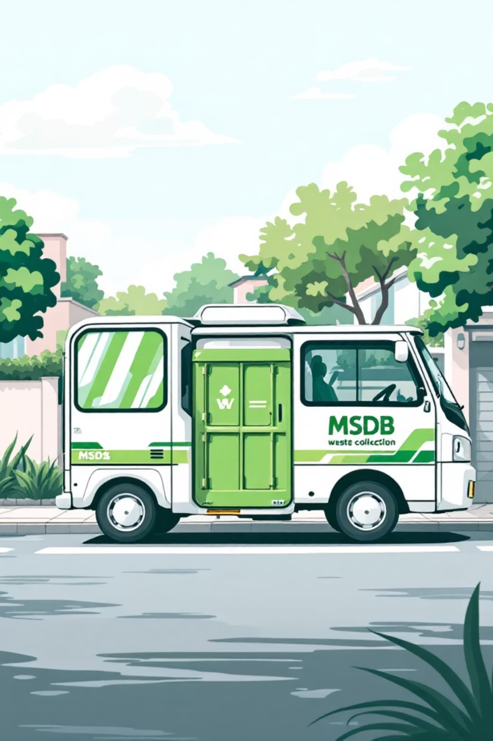
Next-Gen: MSDB-on-Wheels
An EV-based mobile collection unit that brings a staffed MSDB to neighborhoods on a schedule. Integrated scales, cold compartment for organics, and route optimization to reduce emissions and increase collection coverage.

Slide 9

The Reward Ecosystem
Earn Points
Points awarded per kilogram and by material quality; bonus incentives for consistent segregation.
Local Redemption
Partner network (Jigarthanda shops, messes, kirana stores) accepts points for discounts—drives local commerce.
Transparent Ledger
Municipal visibility into rewards issued, fraud checks, and partner reconciliation.

Slide 10
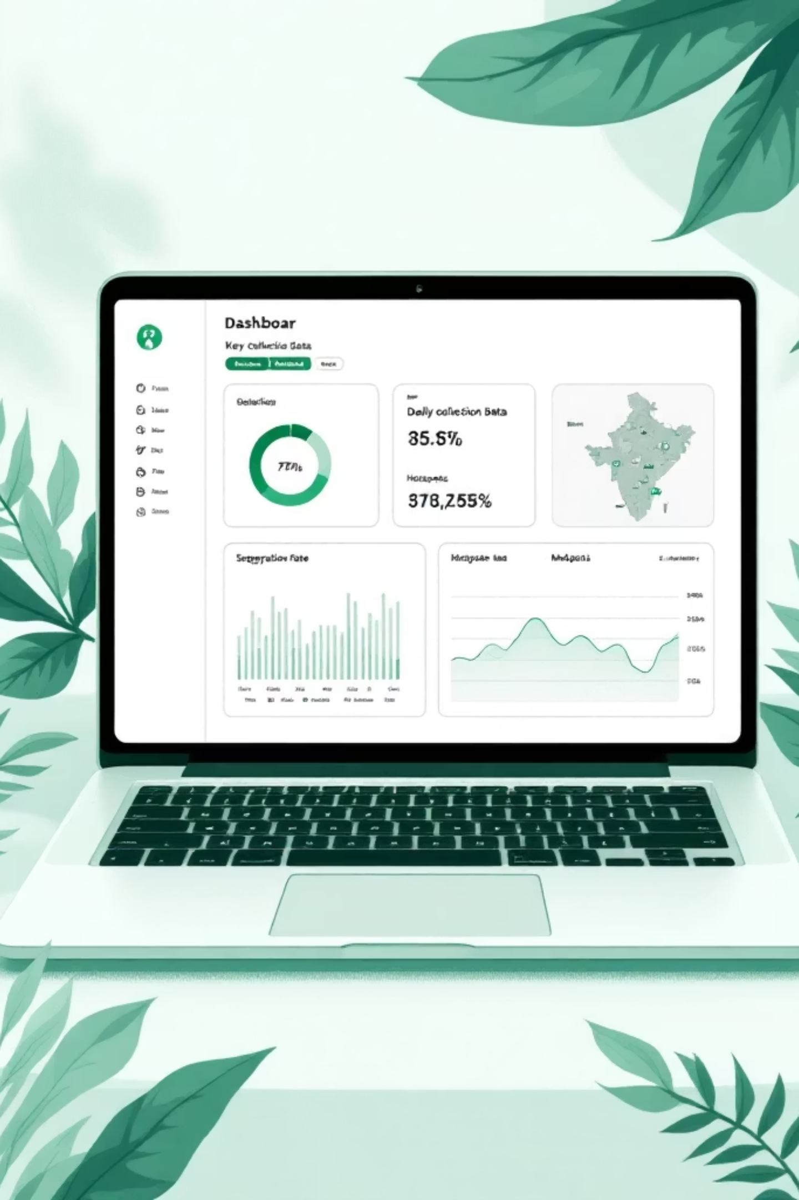

Impact, Revenue & Vision
Central KPI Dashboard
Live metrics: collection volumes, segregation rate, hotspots, and route efficiency for municipal planners.
Revenue Streams
Sell high-grade recycled plastic to aggregators and convert organics into bio-fertilizer—diversified, local revenue.
Vision & Team
Scaled citywide deployment across Madurai. Presented by [Your Name].
Closing image concept: MSDB booth in front of Meenakshi Amman Temple — culturally resonant, community-first, sustainable innovation.

